Slide 1
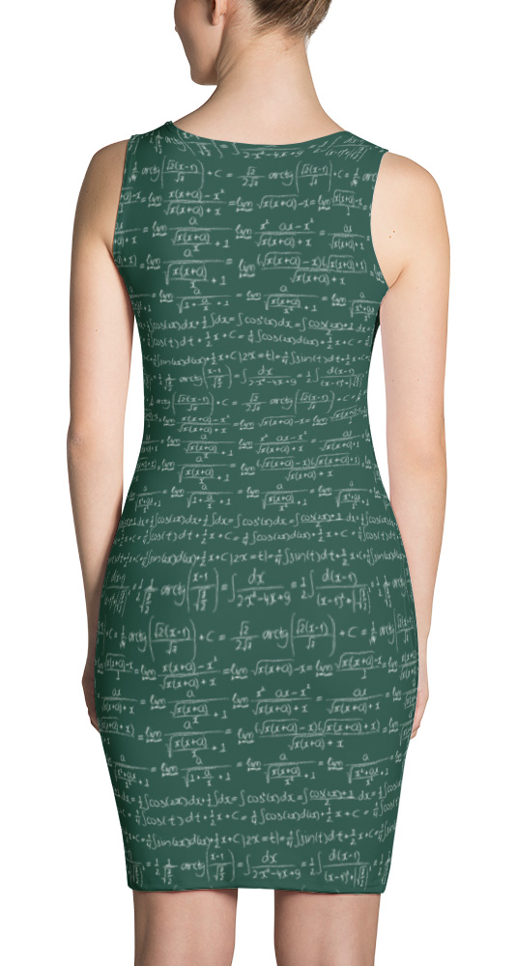
Lecture 13
Introduction to Mathematical Modeling

Slide 2
Lecture 13:
Introduction to Mathematical Modeling
What is a Model?
Example of Models
Cautions about Modeling

Slide 3
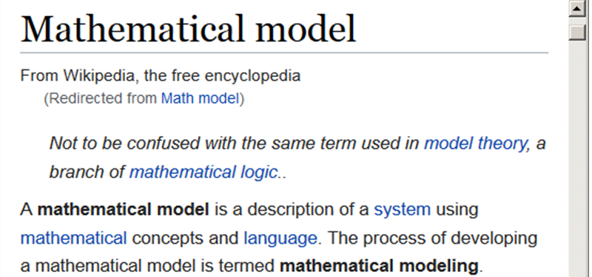
What is a “mathematical model”?

Slide 4
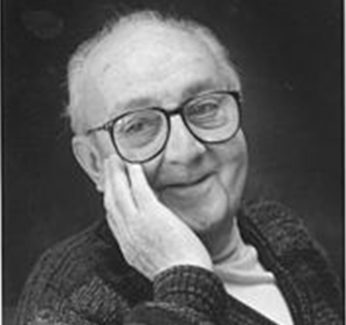
Math models provide a powerful way of thinking about the world
“All models are wrong, but some are useful”
-- George Box

Slide 5
https://physics.stackexchange.com/questions/170962/could-we-send-a-man-safely-to-the-moon-in-a-rocket-without-knowledge-of-general
Newton’s Law of Gravity is a math model:
F = G m₁m₂ / d²
Newton’s Law of Gravity is wrong!
… but it is accurate enough to put men on the moon!
Effect of general relativity on Earth-moon transfer orbit is ~1.3cm
“All models are wrong, but some are useful”

Slide 6
Math models can be used for …
… “description”: describing / summarizing existing data as they are
… “passive prediction”: making predictions about similar / future data if no changes are made
… “causal inference”: predicting what will happen if changes are made
Be sure to interpret models correctly!

Slide 7
Example of interpreting models:
Description: people who drink >6 cups of coffee have a higher rate of death
Prediction: if we know someone drinks > 6 cups of coffee a day, we predict that person is at a higher risk than others
Causal inference: if people quit drinking coffee, everyone’s risk of death would be as low as for those who never drank coffee
Be sure to interpret models correctly!

Slide 8
Simple examples of math models
Predicting house of price from SQFT
Predicting salmon’s weight from length
(Knowing this model would have been very useful for Norvell Boufford)
Predicting child’s IQ based on number of months of breast-feeding
Predicting amount of fire damage based on number of firefighters at fire

Slide 9

Math models in Finance:
Example of math models in Finance:
Estimating risk and return for equities

Slide 10
Two lessons from Finance
Diversification reduces risk
Some risk can not be diversified away
If some risks affect the whole system so that all stocks are affected, diversification doesn’t help

Slide 11
One measure of a stock’s sensitivity to systematic risk is its “beta”
Beta is a measure of how much a stock differs when the market differs by 1%
E(r_{stock}) = r_{risk-free} + “beta_{stock}” (r_{market} – r_{risk-free})
This is the Capital Asset Pricing Model [CAPM]
r_{risk-free} ~ 2.4% (based on 10-year T-bond)
r_{market} – r_{risk-free} = price of risk (~7% or so?)
By definition, beta for the “market” is 1.0; different securities will have different beta’s, depending on their risk

Slide 12
One measure of a stock’s sensitivity to systematic risk is its “beta”
Beta is a measure of how much a stock differs when the market differs by 1%
E(r_{stock}) = r_{risk-free} + “beta_{stock}” (r_{market} – r_{risk-free})
To estimate a stock’s beta, use regression:
X = change in price of S&P500
Y = change in stock price
Slope of regression line is the estimated “beta” for the stock

Slide 13
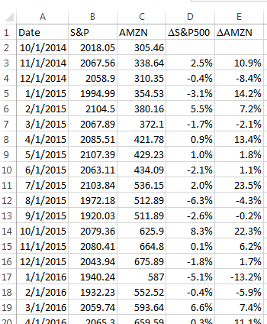
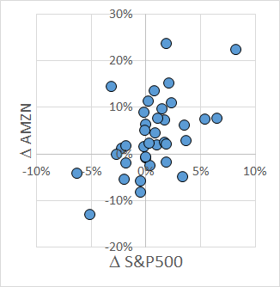
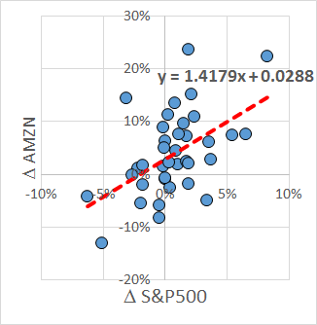
Data are available for monthly share price of AMZN and S&P500 from 11/1/2014 to 11/1/2017
beta_{AMZN} = 1.42

Slide 14
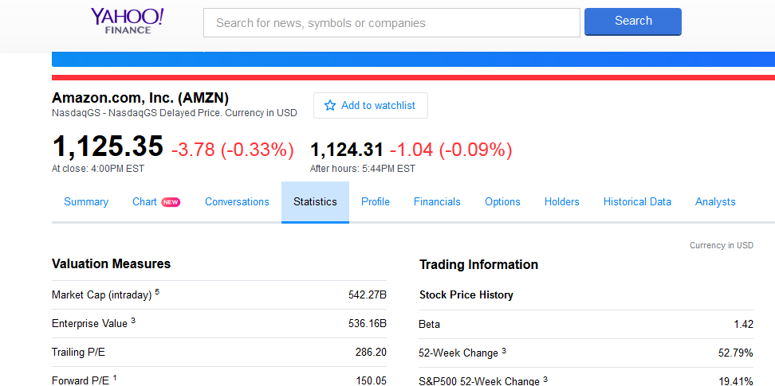
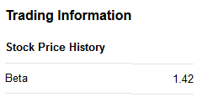
Data are available for monthly share price of AMZN and S&P500 from 11/1/2014 to 11/1/2017
beta_{AMZN} = 1.42

Slide 15
Data are available for monthly share price of AMZN and S&P500 from 11/1/2014 to 11/1/2017
Going beyond the information provided given by finance.yahoo.com:
Q: What is a 95% conf. interval for beta_{AMZN}?
A: 0.605 to 2.231
beta_{AMZN} = 1.42

Slide 16
Using beta:
Beta is typically used to estimate cost of equity capital [i.e., rate of return required by investors to own a stock with that level of risk]
Recall CAPM:
E(return) = r_{F} + beta * (market price of risk)
Higher beta
→ higher systematic risk
→ higher required rate of return

Slide 17
If beta_{AMZN} = 1.42, what is [an estimate of] the required rate of return?
CAPM: E(return) = r_{F} + beta*(price of risk)
r_{F} ~ 2.4%
price of risk ~ 7%
beta_{AMZN} = 1.42
→ E(return) = 12.3%
beta_{AMZN} = 1.42

Slide 18
If beta_{AMZN} = 1.42, what is [an estimate of] the required rate of return?
CAPM: E(return) = r_{F} + beta*(price of risk)
r_{F} ~ 2.4%
price of risk ~ 7%
beta_{AMZN} = 1.42
→ E(return) = 12.3%
If beta_{AMZN} is between 0.605 to 2.231, what is the required rate of return?
→ Required rate of return = 6.6% to 18.0%

Slide 19
What we know:
Data tell us beta_{AMZN} = 1.42
CAPM says that value should increase by 12.3% or so (95% CI: 6.6% to 18.0%)
What happens if AMZN’s rate of return is less than the required amount?
… then investors sell AMZN
… leading to a lower share price of AMZN
… thus increasing the relative rate of return on AMZN (since the denominator is now smaller)
… until the price of AMZN is low enough that the required rate of return is met

Slide 20
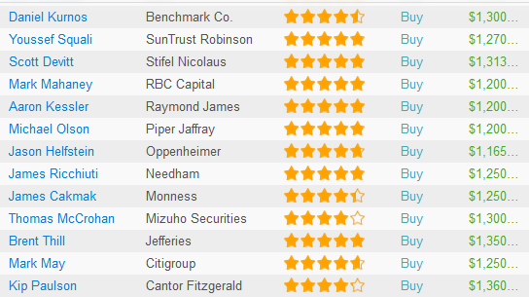
https://www.tipranks.com/stocks/amzn/price-target
On 11/10/2017, AMZN was $1125.35
13 analysts provided “price targets”:
Average price target = $1262.15
→ required return = 1262.15 / 1125.35 – 1 = 12.2%

Slide 21
Summary of analysis for AMZN:
Professional analysts estimated that return for AMZN = 12.2%
n = 13 analysts, SD = 5.4%
→ 95% conf. interval for mean = 8.9% to 15.4%
Free data (http://www.finance.yahoo.com) + simple regression model (CAPM) → estimated return for AMZN ~ 12.3%
95% conf. interval for return (based on 95% conf. interval for beta_{AMZN}) = 6.6% to 18.0%

Slide 22
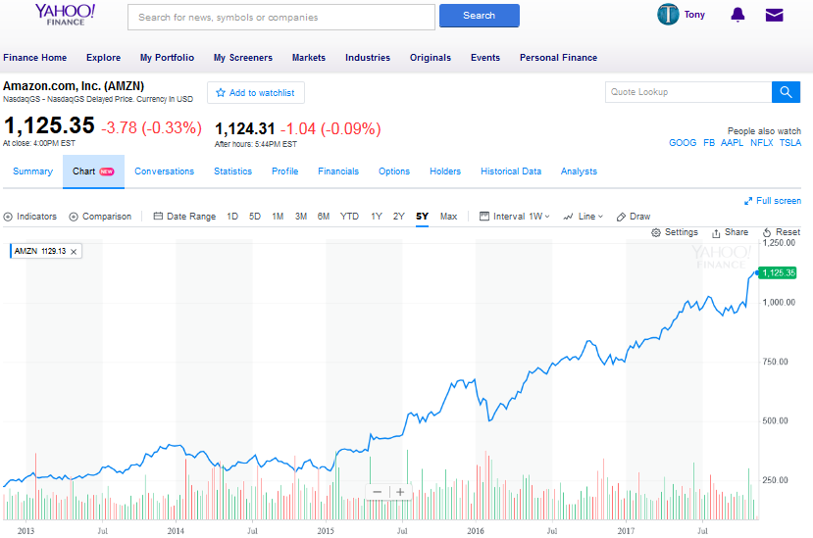
You already have the tools to able to perform powerful financial analyses!

Slide 23
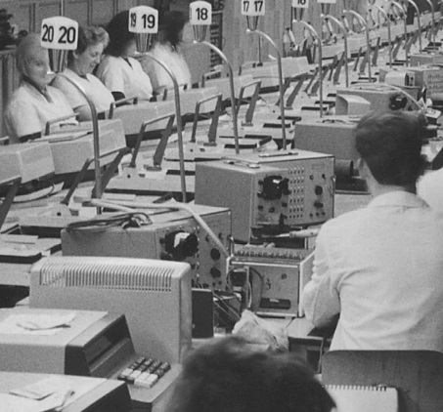
Another example of applying math modeling: deciding business strategy

Slide 24
Most companies have some information easily available; e.g.,
Company’s internal cost of production
Company’s annual sales (dollars, units)
Size of global market, including projections for the next few years
Sales by largest competitors
Combining easily-available information with math models can lead to powerful insights

Slide 25
Company M is trying to decide whether to increase production of “boxes”
“Boxes” used to sell in year 1 for $146
Company M started producing “boxes” in year 2 and has increased production since
Company M knows its production costs and its annual sales figures …
Year |  | # manuf. | Cost of last unit | Total # sold | Total $ revenue
2 | Mid-year | 20,500 | 79 | 76,000 | $ 8.4M
 | End of year | 55,500 | 44
3 | Mid-year | 109,000 | 30 | 264,000 | $18.4M
 | End of year | 155,000 | 23
4 | Mid-year | 348,000 | 17 | 810,000 | $23.7M
 | End of year | 462,000 | 14

Slide 26
Company M is trying to decide whether to increase production of “boxes”
Company M also has data (from newspapers, press releases, etc.) about the size of the market and a few of the largest competitors
Global sales of “boxes” (millions of units)
Year | Total sold | Sold by “T” | Sold by “R” | Sold by “B” | Sold by “C”
1 | 2.5
2 | 5
3 | 15 | 2.0 | 0.8 | 1.2 | 1.0
4 | 25 | 5.0 | 1.6 | 2.0 | 1.2
5 | 46 est.
6 | 67 est.
7+ | 40 est.

Slide 27
What should Company M do?
Internal data for Company M
Year |  | # manuf. | Cost of last unit | Total # sold | Total $ revenue
2 | Mid-year | 20,500 | 79 | 76,000 | $ 8.4M
 | End of year | 55,500 | 44
3 | Mid-year | 109,000 | 30 | 264,000 | $18.4M
 | End of year | 155,000 | 23
4 | Mid-year | 348,000 | 17 | 810,000 | $23.7M
 | End of year | 462,000 | 14
Global sales of “boxes” (millions of units)
Year | Total sold | Sold by “T” | Sold by “R” | Sold by “B” | Sold by “C”
1 | 2.5
2 | 5
3 | 15 | 2.0 | 0.8 | 1.2 | 1.0
4 | 25 | 5.0 | 1.6 | 2.0 | 1.2
5 | 46 est.
6 | 67 est.
7+ | 40 est.

Slide 28
What should Company M do?
Possibilities:
Idea #1: expand, spend $7M for additional plant capable of manufacturing an additional 810K per year
Idea #2: status quo: continue with business, but do not expand
Idea #3: exit the business
Without data, we’d just be guessing …

Slide 29
Some knowledge that would be useful:
What are our costs?
What are our prices?
What is the expected return on investment (change in costs and quantities) for investing in the new plant?

Slide 30
Some knowledge that would be useful:
What are our costs?
What are our prices?
What is the expected return on investment (change in costs and quantities) for investing in the new plant?

Slide 31
Model 1: estimating internal costs
For cost data, the “Learning curve” model is often (but not always!) appropriate
Recall: to use the learning curve,
Compute cumulative n
Use ln(cumulative n) to predict ln(cost); get equation “pred ln(cost) = b₀ + b₁ ln(cum n)”
Math fact: if costs follow the learning curve, then the average cost for the units n₁ to n₂ is
 = [exp(b₀)/(b₁ + 1)][n₂^{b1+1} – n₁^{b1+1}]/(n₂ – n₁)

Slide 32
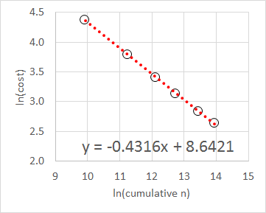
Model 1: estimating internal costs
Compute cum n, use ln(cum n) → ln(cost)
predicted ln(cost) =
8.6421 – 0.4316 ln(cum n)
⬄ C = 5665 n^{–0.4316}
Implied learning curve = 74%
Year |  | # manuf | cost of last unit | cum n | ln(cum n) | ln(cost)
2 | Mid-year | 20,500 | 79 | 20,500 | 9.9282 | 4.3694
 | End of year | 55,500 | 44 | 76,000 | 11.2385 | 3.7842
3 | Mid-year | 109,000 | 30 | 185,000 | 12.1281 | 3.4012
 | End of year | 155,000 | 23 | 340,000 | 12.7367 | 3.1355
4 | Mid-year | 348,000 | 17 | 688,000 | 13.4415 | 2.8332
 | End of year | 462,000 | 14 | 1,150,000 | 13.9553 | 2.6391

Slide 33
Model fits the data well:
r(ln cum n, ln cost) = –0.9998
Costs are predicted to decrease further
Predicted cost at n = 1.15M → $13.73
Actual cost at n = 1.15M was $14
Predicted cost at n = 2M → $10.81
95% conf. limit for average cost is $10.47 to $11.15
Predicted cost at n = 3M → $9.07
95% conf. limit for average cost is $8.76 to $9.40
What about price?

Slide 34
Some knowledge that would be useful:
What are our costs?
What are our prices?
What is the expected return on investment (change in costs and quantities) for investing in the new plant?

Slide 35
We do have price data!
We were told in year 1 that price = $146
For years 2, 3, and 4, we can derive price per unit as (total $ sales) / (total # sold)
Idea for price model: ln(year) → ln(price)?
r(ln year, ln price) = –0.9046
→ pred. ln(price) = 5.1685 – 1.0587 ln(year)
Year | Total # sold | Total $ revenue | Price per unit = ($ sales) / (# units)
1 | - |  | $146.00
2 | 76,000 | $ 8.4M | 110.53
3 | 264,000 | $18.4M | 69.70
4 | 810,000 | $23.7M | 29.26

Slide 36
We now have a model for cost and a model for price … now we can model future years

Slide 37
Some knowledge that would be useful:
What are our costs?
What are our prices?
What is the expected return on investment (change in costs and quantities) for investing in the new plant?

Slide 38
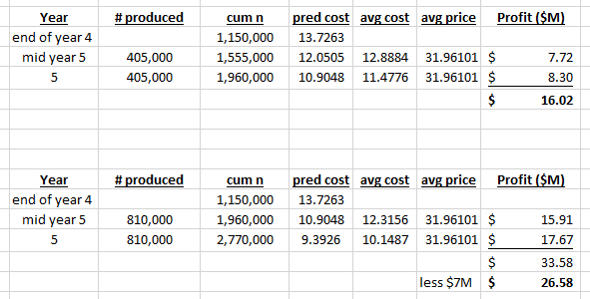
Two calculations:
Cost model:
ln(cost of unit n) = 8.6421 – 0.4316 ln(cum n)

Slide 39
Two calculations:
“Average” cost during time period calculated as average of cost at start of period (i.e., cost at end of last period) and end of current period

Slide 40
Two calculations:
pred. ln(price) = 5.1685 – 1.0587 ln(year)
(Note model gave average price for whole year)

Slide 41
Two calculations:
Calculated profit for year 5 without new plant = $16M
Calculated net profit for year 5 with new plant = $26M ($34M – $7M)
New plant allows us to produce more units, thus generating more profit

Slide 42
What do you recommend?
Expand
Status quo
Exit
Calculated profit for year 5 without new plant = $16M
Calculated net profit for year 5 with new plant = $26M ($34M – $7M)
New plant allows us to produce more units, thus generating more profit

Slide 43
What are critical assumptions of this analysis?
Cost to produce “box”
Price at which “box” can be sold
Some other possible considerations
What if price doesn’t behave as modeled?
What will the competition do?

Slide 44
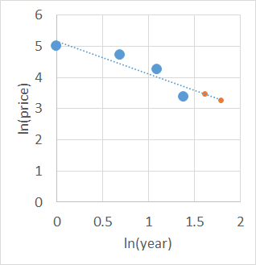
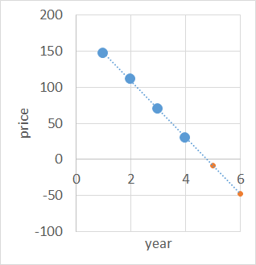
Price model
Prev. price model uses ln(year) → ln(price)
How well does model fit the data?
How well do other models fit the data?
Predicted prices go negative … not possible, but not a good sign!

Slide 45
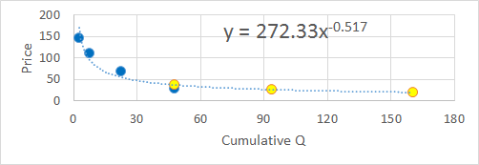
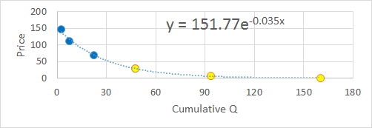
Price model
Why use year to predict price?
Economic theory suggest P is related to Q
This is important, because Q is increasing!
$37 pred v. $29 actual
ln(cum Q) → ln(P)
[“Power Law”]
Pred P @ 5 = $26.10
Pred P @ 6 = $19.74
Cum Q → ln(P)
[“Exponential decay”]
Pred P @ 5 = $5.89
Pred P @ 6 = $0.57
$29 pred v. $29 actual

Slide 46
More realistic economic models (using Q, not time, to predict P) suggest a crash in price is coming!
$37 pred v. $29 actual
ln(cum Q) → ln(P)
[“Power Law”]
Pred P @ 5 = $26.10
Pred P @ 6 = $19.74
Cum Q → ln(P)
[“Exponential decay”]
Pred P @ 5 = $5.89
Pred P @ 6 = $0.57
$29 pred v. $29 actual

Slide 47
GSBA 545 lesson: think carefully about every model (the variables used and the assumed equation)
Choice of model can have a large effect!
$37 pred v. $29 actual
ln(cum Q) → ln(P)
[“Power Law”]
Pred P @ 5 = $26.10
Pred P @ 6 = $19.74
Cum Q → ln(P)
[“Exponential decay”]
Pred P @ 5 = $5.89
Pred P @ 6 = $0.57
$29 pred v. $29 actual

Slide 48
(And don’t let yourself be intimidated by fancy-looking spreadsheets!)

Slide 49
Looking at P versus Q suggests a crash in prices is coming …
But what if prices stay high … is there a chance we could build up a profit?
$37 pred v. $29 actual
ln(cum Q) → ln(P)
[“Power Law”]
Pred P @ 5 = $26.10
Pred P @ 6 = $19.74
Cum Q → ln(P)
[“Exponential decay”]
Pred P @ 5 = $5.89
Pred P @ 6 = $0.57
$29 pred v. $29 actual

Slide 50
Remember, Company M is not alone …
Company T has already produced ~7M boxes and clearly have larger capacity
If learning curves are the same, cost per unit for T is $6.30 (v. $13.73 for M)
What will happen if it looks like we are starting to become profitable, or a threat?
Global sales of “boxes” (millions of units)
Year | Total sold | Sold by “T” | Sold by “R” | Sold by “B” | Sold by “C”
1 | 2.5
2 | 5
3 | 15 | 2.0 | 0.8 | 1.2 | 1.0
4 | 25 | 5.0 | 1.6 | 2.0 | 1.2
5 | 46 est.
6 | 67 est.
7+ | 40 est.

Slide 51

“It is said that if you know your enemies and know yourself, you will not be imperiled in a hundred battles … if you do not know your enemies nor yourself, you will be imperiled in every single battle.”
-- Sun Tzu, “Art of War”
In the business world, proper math models can help you understand yourself and your competitors!

Slide 52
Lesson from GSBA 545: Make the most of available data!
Even basic data can yield valuable insights
Year |  | # manuf. | Cost of last unit | Total # sold | Total $ revenue
2 | Mid-year | 20,500 | 79 | 76,000 | $ 8.4M
 | End of year | 55,500 | 44
3 | Mid-year | 109,000 | 30 | 264,000 | $18.4M
 | End of year | 155,000 | 23
4 | Mid-year | 348,000 | 17 | 810,000 | $23.7M
 | End of year | 462,000 | 14
Global sales of “boxes” (millions of units)
Year | Total sold | Sold by “T” | Sold by “R” | Sold by “B” | Sold by “C”
1 | 2.5
2 | 5
3 | 15 | 2.0 | 0.8 | 1.2 | 1.0
4 | 25 | 5.0 | 1.6 | 2.0 | 1.2
5 | 46 est.
6 | 67 est.

Slide 53
“The general who wins the battle makes many calculations in his temple before the battle is fought. The general who loses makes but few .”
-- Sun Tzu, “Art of War”
Make many calculations
GSBA 545 can help

Slide 54
PS The real story
Year 1 = 1971, Year 2 = 1972, etc.
The “boxes” were electronic calculators
“Company M” was MOStronics, “Company T” was Texas Instruments
The Division Manager at MOStronics wanted a $7M investment for a new plant
What do you think MOStronics did?
Why do you think they did what they did?

Slide 55
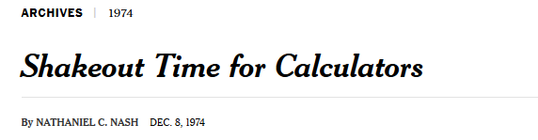
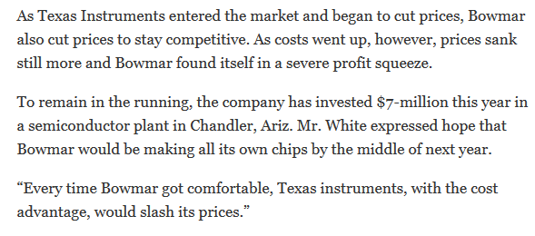

Slide 56
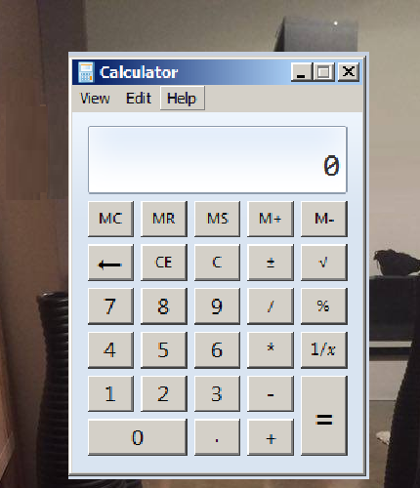
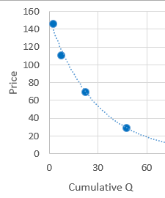
Math models can be very powerful!
Regression plus free data can be used to estimate return for stocks
Regression and logarithms can be used to gain business insights

Slide 57
Undergraduate comment [AA, Spr 07]:
“I have already put some of the more basic regression techniques and tools we touched on to work on several occasions in a consulting environment. As one example, I used a simple linear regression to predict the number of recipients of a particular federal subsidy based on historical and future estimates of federal appropriations for the said program. I'm pleased to say that a Harvard study substantiated my findings shortly after building the model and presenting the data.”

Slide 58
Math models can be very powerful!
Math models can be misleading …

Slide 59
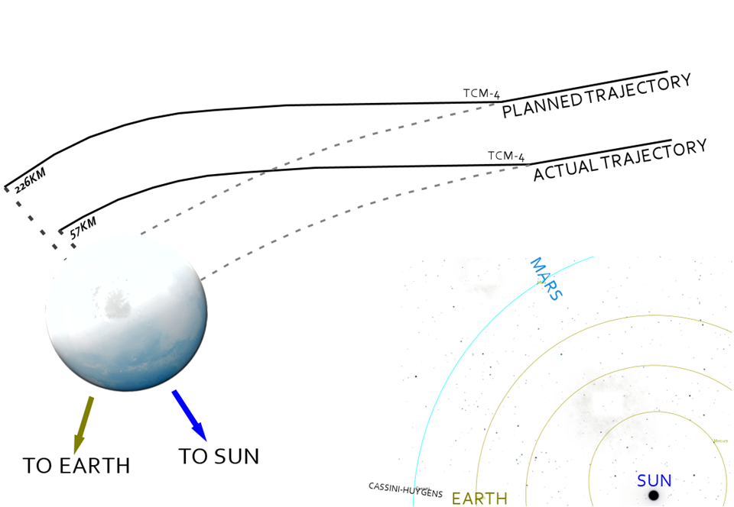

Incorrect math models led to the loss of the Mars Climate Orbiter

Slide 60
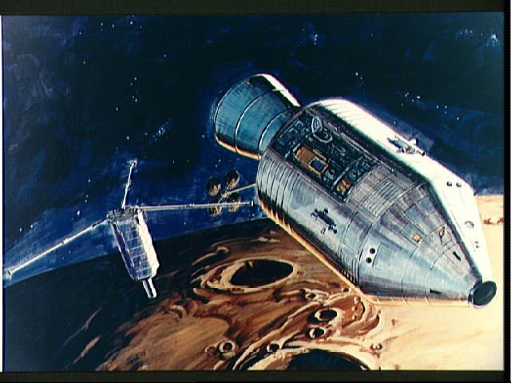
Another loss: PFS-2 was deployed in lunar orbit on 24 April by Apollo 16.

Slide 61
Another loss: PFS-2 was deployed in lunar orbit on 24 April by Apollo 16.
PFS-2 should have been in orbit for at least a year (PFS-1 survived 537 days)

Slide 62
Another loss: PFS-2 was deployed in lunar orbit on 24 April by Apollo 16.
PFS-2 should have been in orbit for at least a year (PFS-1 survived 537 days)
… PFS-2 crashed into the lunar surface after just 34 days

Slide 63
Another loss: PFS-2 was deployed in lunar orbit on 24 April by Apollo 16.
PFS-2 should have been in orbit for at least a year (PFS-1 survived 537 days)
… PFS-2 crashed into the lunar surface after just 34 days
How can models for gravity go wrong?

Slide 64
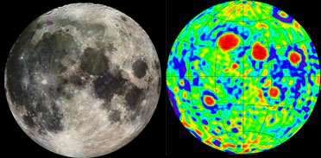
NASA modeled the moon as a sphere …
It turns out the moon’s gravity is “lumpy”!

Slide 65
Math models can be very powerful!
Math models can be misleading…
Be careful when using math models:
Always check models against actual data
Check to see if other models fit the data
Beware of unreasonable extrapolation
Beware of misinterpreting results

Slide 66
Math models can be very powerful!
Math models can be misleading…
Be careful when using math models:
Always check models against actual data
Check to see if other models fit the data
Beware of unreasonable extrapolation
Beware of misinterpreting results

Slide 67
Always check models against real data!
If a model can’t match existing data, it probably isn’t a good model to use

Slide 68
For MOStronics, using ln(year) to predict ln(price) did not fit the actual data well:
Year | Actual Price |  | Predicted P from ln(year) → ln(P)
1 | $146 |  | $176
2 | 111 |  | 84
3 | 70 |  | 55
4 | 29 |  | 40

Slide 69
For MOStronics, using ln(year) to predict ln(price) did not fit the actual data well:
The model was too optimistic in year 4 (predicted price = $40 v. actual = $29)
Year | Actual Price |  | Predicted P from ln(year) → ln(P)
1 | $146 |  | $176
2 | 111 |  | 84
3 | 70 |  | 55
4 | 29 |  | 40

Slide 70
For MOStronics, using ln(year) to predict ln(price) did not fit the actual data well:
The model was too optimistic in year 4 (predicted price = $40 v. actual = $29)
The model failed to match trend in change
Year | Actual Price | Actual Δ% | Predicted P from ln(year) → ln(P) | Modeled Δ%
1 | $146 |  | $176
2 | 111 | -24% | 84 | -52%
3 | 70 | -37% | 55 | -35%
4 | 29 | -58% | 40 | -26%

Slide 71
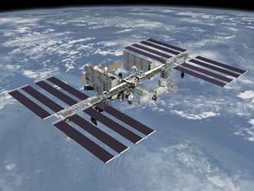
Another example:
On the International Space Station, the chance of failure during one hour of a “Lamp Housing Assembly” usage was modeled as p = 0.0000033
On 12/16/2005, LHA’s had a total of 283,112 hours and n=25 failures
Does the model seem reasonable?

Slide 72
Summary:
Model: P(failure per hour) = 0.0000033
Data: 25 failures in 283,112 hours
P(25+ failures in 283,112 | p) = 6 x 10^{–27}
Conclusion: modeled rate was wrong!
Always check models against real data!
If the model can’t match existing data, it probably isn’t a good model to use
(NASA revised their estimated, based on these data)

Slide 73
Math models can be very powerful!
Math models can be misleading…
Be careful when using math models:
Always check models against actual data
Check to see if other models fit the data
Beware of unreasonable extrapolation
Beware of misinterpreting results

Slide 74
Math models can be very powerful!
Math models can be misleading…
Be careful when using math models:
Always check models against actual data
Check to see if other models fit the data
Beware of unreasonable extrapolation
Beware of misinterpreting results

Slide 75
Just because a model fits the data doesn’t mean the model is correct … other models might fit the model, too
Calculator price could be predicted from year … price could be predicted better from quantity of calculators produced (and that model makes more economic sense)
If it is no clear “best” model (how best to predict MB housing price from SQFT?), try multiple models and compare results

Slide 76
Math models can be very powerful!
Math models can be misleading…
Be careful when using math models:
Always check models against actual data
Check to see if other models fit the data
Beware of unreasonable extrapolation
Beware of misinterpreting results

Slide 77
Math models can be very powerful!
Math models can be misleading…
Be careful when using math models:
Always check models against actual data
Check to see if other models fit the data
Beware of unreasonable extrapolation
Beware of misinterpreting results

Slide 78
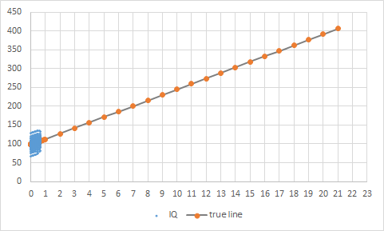
A silly example of unreasonable extrapolation: predicting IQ of 406 after 21 years of breast-feeding

Slide 79
Unreasonable extrapolations can be amusing, but don’t make the mistake of taking such extrapolations seriously …
… unlike these authors, who did take their extrapolations seriously …

Slide 80
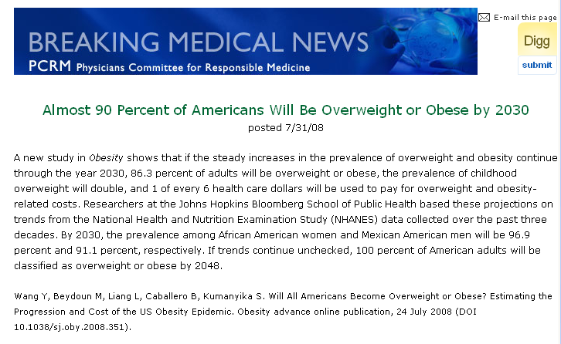
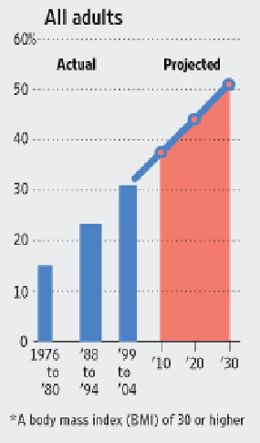
How bad is obesity in America?
“… 100 percent of American adults will be classified as overweight or obese by 2048”
Beware of excessive extrapolation

Slide 81
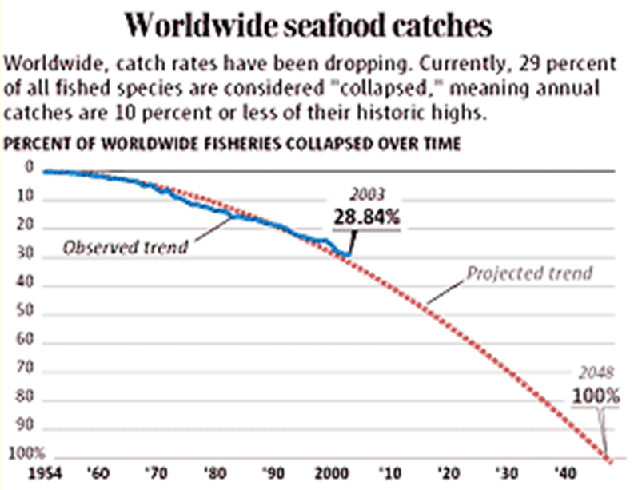
Is seafood doomed to extinction?
Beware of excessive extrapolation

Slide 82
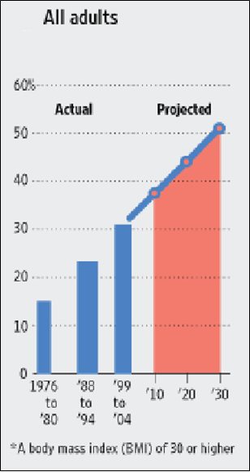
Beware of unreasonable extrapolation!

Slide 83
Math models can be very powerful!
Math models can be misleading…
Be careful when using math models:
Always check models against actual data
Check to see if other models fit the data
Beware of unreasonable extrapolation
Beware of misinterpreting results

Slide 84
Math models can be very powerful!
Math models can be misleading…
Be careful when using math models:
Always check models against actual data
Check to see if other models fit the data
Beware of unreasonable extrapolation
Beware of misinterpreting results

Slide 85
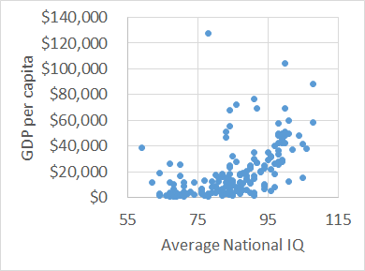
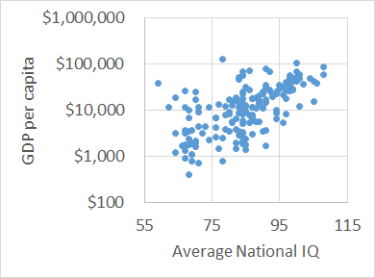
In 2002, authors Lynn and Vanhanen reported a correlation between
“average IQ of people in a country”
“country’s per capita GDP”
Qatar

Slide 86
In 2002, authors Lynn and Vanhanen reported a correlation between
“average IQ of people in a country”
“country’s per capita GDP”
“Whereas the average IQ of Finns is 97, in Africa it is between 60 and 70. Differences in intelligence are the most significant factor in explaining poverty.” – Tatu Vanhanen
Beware of misinterpreting results!
Association is not necessarily causation

Slide 87
What might explain the correlation?
Maybe low IQ does cause low GDP …
Or maybe low GDP causes low IQ …
Or maybe there is another factor (e.g., how people in high GDP countries define IQ?)
Qatar

Slide 88
Before concluding that A causes B, ask
… could the results be just coincidence?
Perform an appropriate test of stat. significance
… could it be that, actually, B causes A?
Ex-smokers have a lower health status than current smokers … does quitting lower health?
… could it be that there is a third factor that relates to both A and B?
Fire fighters and amount of fire damage; cups of coffee and risk of mortality
Be cautious before concluding causality!

Slide 89
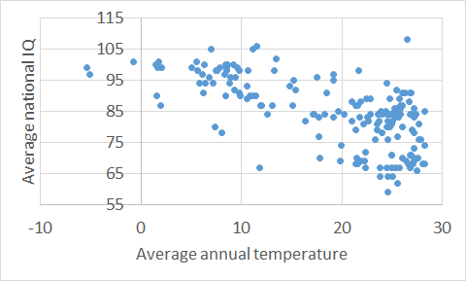
`
In 2006, Lynn then reported a correlation between
“average IQ of people in a country”
“average annual temperature in a country”
Singapore

Slide 90
In 2006, Lynn then reported a correlation between
“average IQ of people in a country”
“average annual temperature in a country”
From this, Lynn concluded that African nations had low IQ’s because the average temperature was too high
Beware of misinterpreting results!
Association is not necessarily causation

Slide 91

Causal conclusions (and public policy decisions!) in the news
After abortion was legalized, homicides decreased …
so abortions caused a decrease in homicide rates?

Slide 92
Student comment [SB, Fall 06]:
“One very important think that I have found is really realizing that correlation does not imply causality. It's really amazing how many people make that jump not just in stats, but in other areas of life. That is a concept I use a lot as well as looking at how various statistics are derived, what confidence interval they use etc. ”

Slide 93
Summary so far
Math models are very powerful
Math models can be misleading
Be careful when using math models
Check that model matches real data
Consider alternative models
Beware of unreasonable extrapolations
Be careful about interpretation of models

Slide 94
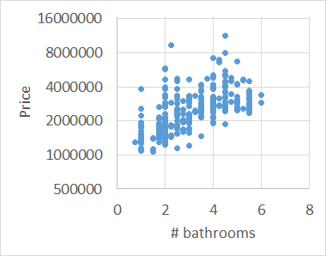
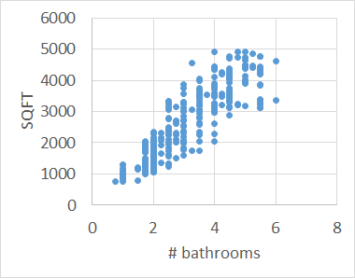
More complicated models:
In Manhattan Beach, houses with more bathrooms tend to sell for more …
… but houses with more bathrooms also tended to have larger overall SQFT

Slide 95
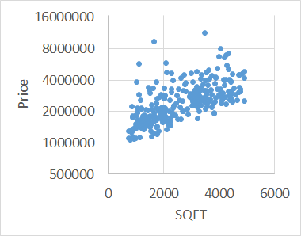
How much does house price in MB depend on “number of bathrooms”, and how much depends on overall SQFT?
This is a difficult question …

Slide 96
Next time: Lecture 14
Introduction to Multiple Regression

Slide 98

 $\hat{p} \hat{y}$

